Slide 1


SMART Pest Control

Slide 2


SMART
Who?
What?
Why?
Where?
When?
Notes:
I

Slide 3
SMART Who?
Shopping Centre
Restaurant
High Street Retailer
Office Block
Distribution Warehouse
University Computer Block
Train engineering complex
Hospital
Notes:
I

Slide 4
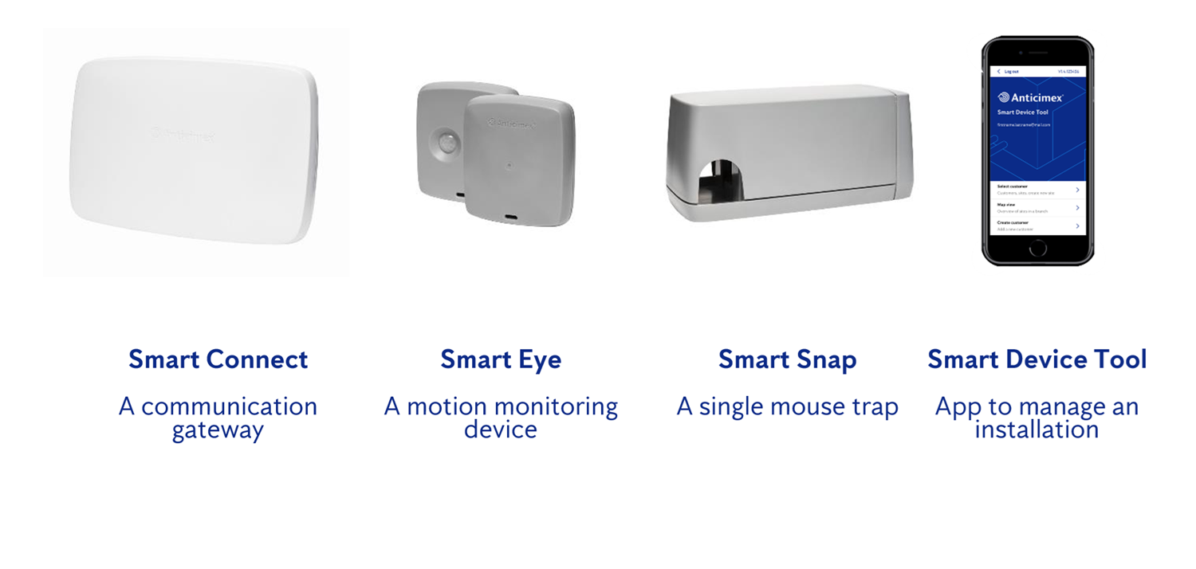
SMART What?
Notes:
I

Slide 5
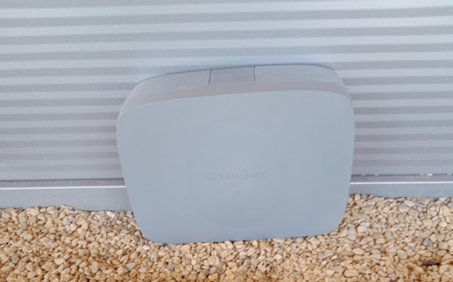
SMART Range-Smart Catch

Slide 6
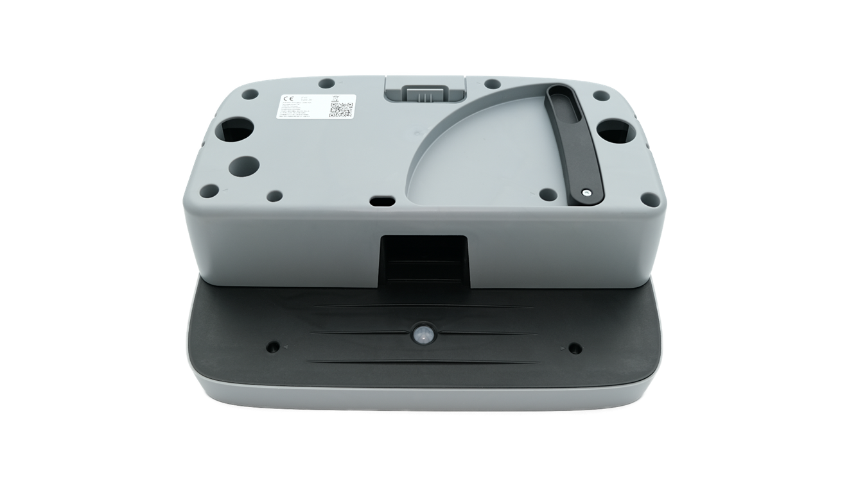
SMART Range-Smart Catch

Slide 7
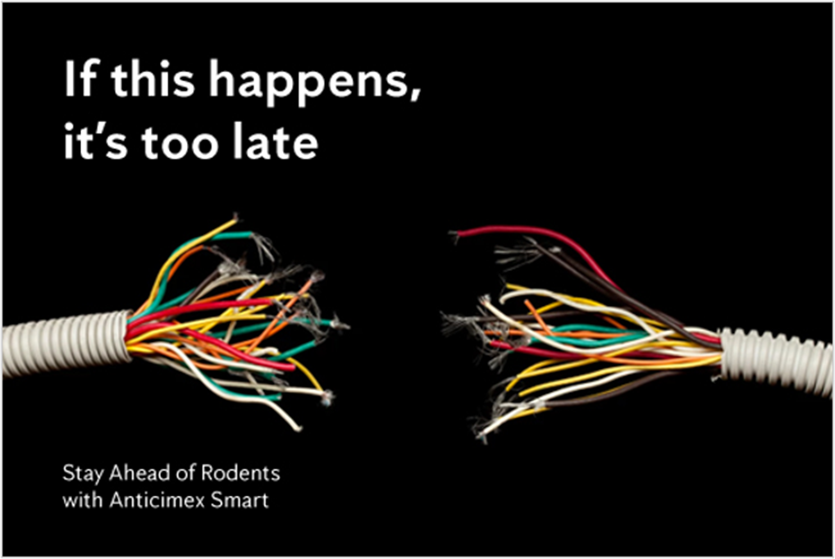
SMART Why?
Notes:
I

Slide 8
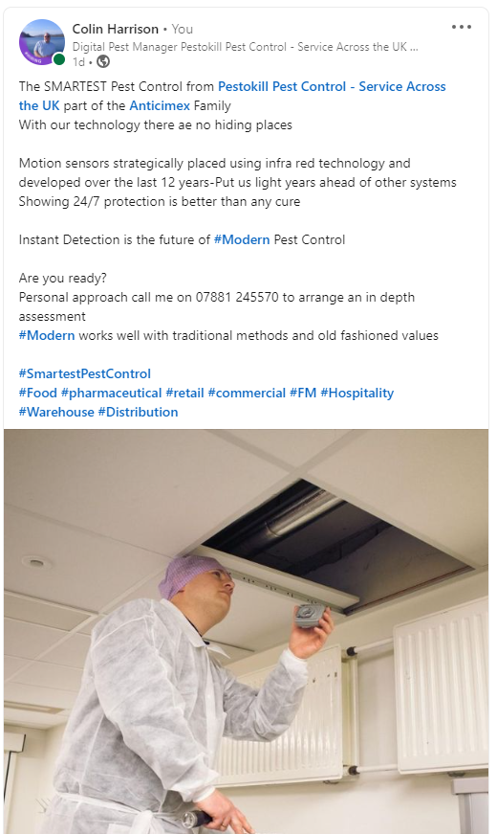
SMART Why?
Notes:
I

Slide 9
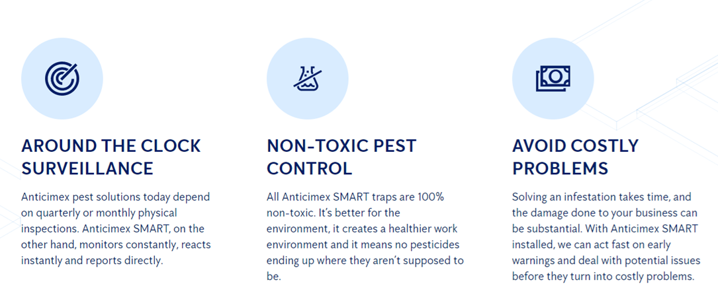
SMART Why?
Notes:
I

